Slide 1
Music Store Analysis
SQL Project
By Monika Devi

Slide 2
Background
The Music Store Data Analysis project offers a comprehensive analysis of the music store's data to facilitate better decision-making, identify trends, and understand customer behavior. This project provides valuable answers to optimize inventory management, target marketing campaigns, and make informed business decisions.

Slide 3
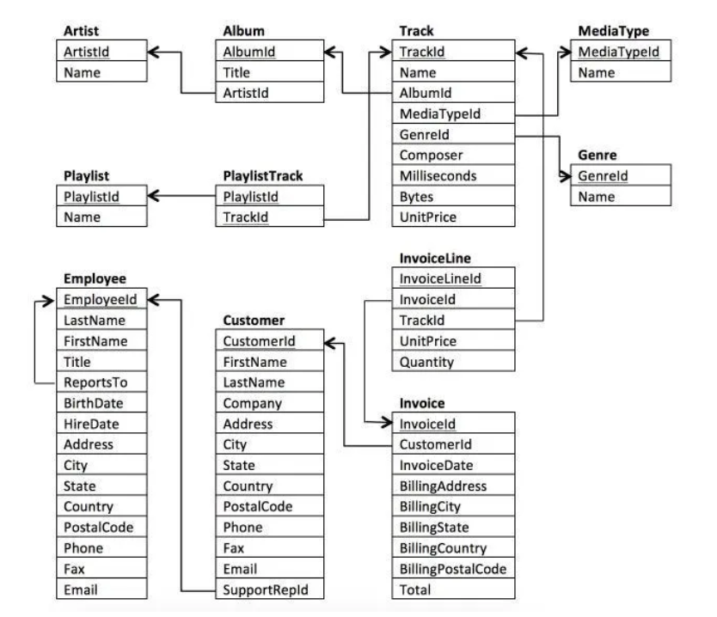
Dataset Description
The dataset has 11 tables: - Employee, Customer, Invoice, InvoiceLine, Track, MediaType, Genre, Album, Artist, Play list Track, and Playlist, as well as their associations.

Slide 4
Analytical Approach
The Analysis employs SQL queries to find information ,Transform, and analysis the data. Key metrics and insights are derived using various SQL technique , including aggregation, join and filtering. This approach enables a comprehensive understanding of the sales dynamics and customer behavior

Slide 5
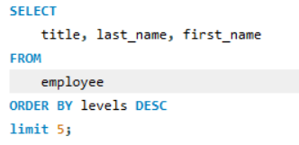
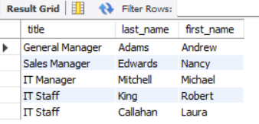
1. The senior most employee based on job title

Slide 6

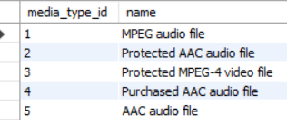
2. All types of media

Slide 7

3. Total number of Artist

Slide 8
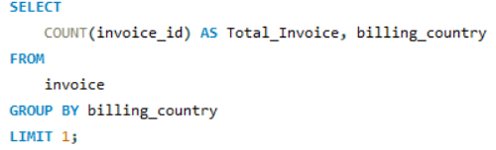

4. which countries have the most invoices

Slide 9
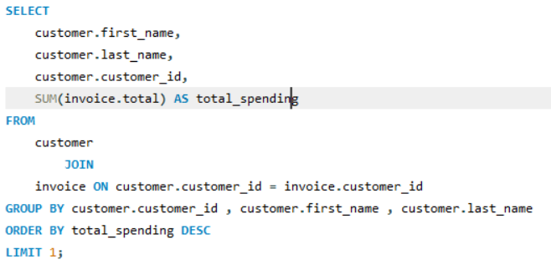

5. The person who has spent the most money

Slide 10
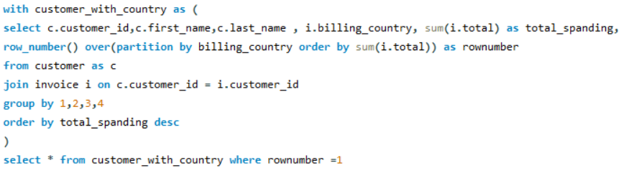
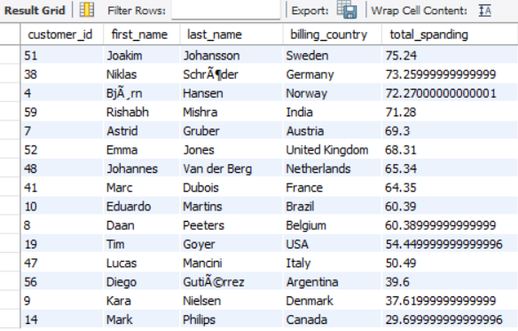
6. country along with the top customer and how much they spent.

Slide 11
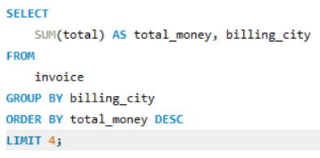
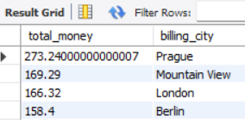
7. which city has best customers? We would like to throw a promotional music Festival-- in the city we made the most money. write a query that returns one city that has Highest sum -- of invoice totals. Return both the city name & sum of all table invoice total?

Slide 12
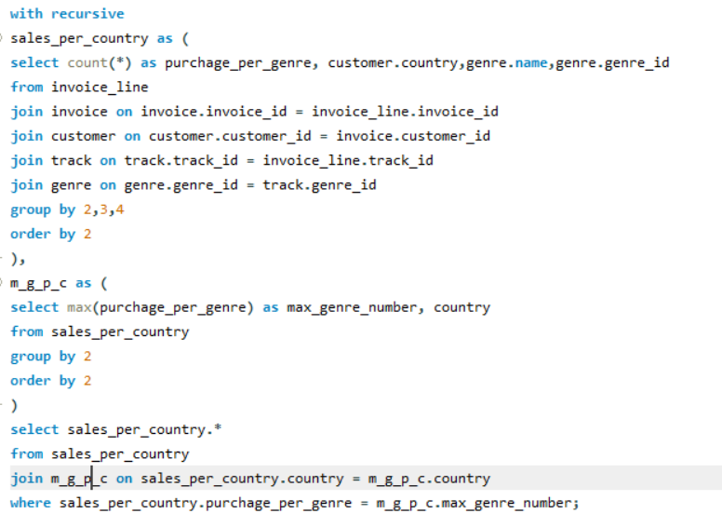
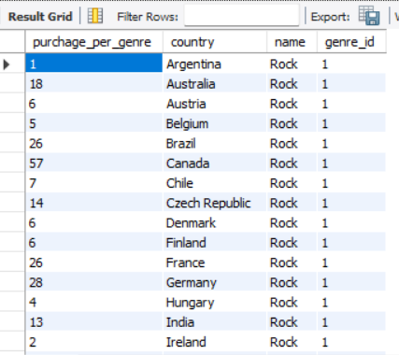
8. We want to find out the most popular music Genre for each country. We determine the -- most popular genre as tha genre with the highest amount of purchases.

Slide 13
Thank you

